Slide 1


Name : Grishma gedela
SkillsBuild Email ID : grishmagedela@gmail.com
College Name : SIR C R REDDY COLLEGE OF ENGINEERING
College State : ANDHRA PRADESH
Internship Domain : Front-End Development
Internship Start and End Date : 24th June 2024 to 31st July 2024

Slide 2
Cloning The " NExt web " website
Project Topic
Cloning "The Next Web" website using HTML, CSS, and JavaScript to create a centralized platform that aggregates and curates relevant tech news, providing real-time updates and an intuitive user experience.
Problem Statement
Tech enthusiasts and industry professionals often face challenges such as:
Spending time on irrelevant articles.
Struggling to find in-depth coverage of the topics that matter.
Juggling multiple websites to stay informed about the latest tech news.
To address these challenges, I cloned the website of The Next Web, which offers a streamlined and efficient way to stay updated with the latest tech news, all in one place.

Slide 3
AGENDA
Project Overview
End Users
Solution and Value Proposition
Customization and Personalization
Technologies Used / Modelling
Results
Links

Slide 4
PROJECT OVERVIEW
Are you frustrated by:
Sifting through irrelevant articles?
Finding it hard to get comprehensive coverage of tech topics that matter to you?
Navigating multiple sites to stay updated?
My Approach:
I cloned "The Next Web" website using HTML, CSS, and JavaScript to address these issues. The platform aggregates top tech news in one place, providing curated content and real-time updates, while ensuring an intuitive and seamless user experience.

Slide 5
PURPOSE, SCOPE AND OBJECTIVES
Purpose:
Provide a centralized platform for accessing curated and up-to-date tech news effortlessly.
Scope:
Design a responsive website mirroring The Next Web.
Implement search functionality.
Integrate News API for real-time updates.
Ensure cross-device compatibility.
Objectives:
Aggregate relevant tech news articles to save users' time.
Enable easy browsing by topics or search.
Provide real-time tech news updates.
Ensure an engaging user experience on all devices.

Slide 6
WHO ARE THE END USERS of this project?
Tech Enthusiasts: Individuals passionate about technology and seeking the latest news and trends.
Industry Professionals: Professionals working in the tech industry who need to stay updated on market trends, innovations, and industry news.
Students: Students studying technology-related fields who require up-to-date information for their studies and projects.
General Audience: Anyone interested in staying informed about technological advancements and news.

Slide 7
YOUR SOLUTION AND ITS VALUE PROPOSITION
Solution:
Developed a cloned version of The Next Web website to provide a comprehensive and centralized platform for accessing the latest tech news.
Implemented features such as search functionality and real-time updates using the News API to enhance user experience.
Value Proposition:
API Integration: Utilized the News API with an API key to dynamically fetch and display the latest tech news. This ensures users receive up-to-date and relevant articles.
Dynamic Content Rendering:
JavaScript: Utilized JS to dynamically generate and display news articles based on the data received from the API.
Form Submission Handling: Added an event listener to manage user input in the search form. JavaScript intercepts the submission, creates a search URL with the user’s keywords, and fetches relevant news articles.

Slide 8
How did you customize the project and make it your own
Search Functionality: Implemented a search bar to allow users to find specific news articles by entering keywords, enhancing the ability to locate relevant content quickly.
Responsive Design: Designed the layout to be fully responsive, ensuring that the website provides a great user experience across different devices and screen sizes.
News API Integration: Integrated the News API to fetch and display real-time tech news updates, ensuring that the content remains current and relevant.
Tailored Design: Adapted the visual design elements, such as color schemes, fonts, and layouts, to align with your specific branding and aesthetic preferences.
User Experience Enhancements: Made various adjustments to improve navigation and user interaction, such as intuitive menu structures and optimized content presentation.

Slide 9
MODELLING
Design and Development Framework
Responsive Web Design: Adapted the site to various devices using CSS media queries.
MVC Architecture: Structured with HTML (Model), CSS (View), and JavaScript (Controller) for organized development.
Technology Principles Utilized
API Integration: Used News API for real-time updates.
Modular Design: Created reusable components for easier maintenance.
User-Centered Design: Focused on intuitive navigation and functionality.
Performance Optimization: Enhanced speed through file minimization and caching.
Cross-Browser Compatibility: Ensured consistent performance across browsers.
Methodologies Applied
Agile Development: Iterated based on feedback for continuous improvement.
User Testing: Gathered and applied feedback to refine usability and functionality.

Slide 10

Results

Slide 11
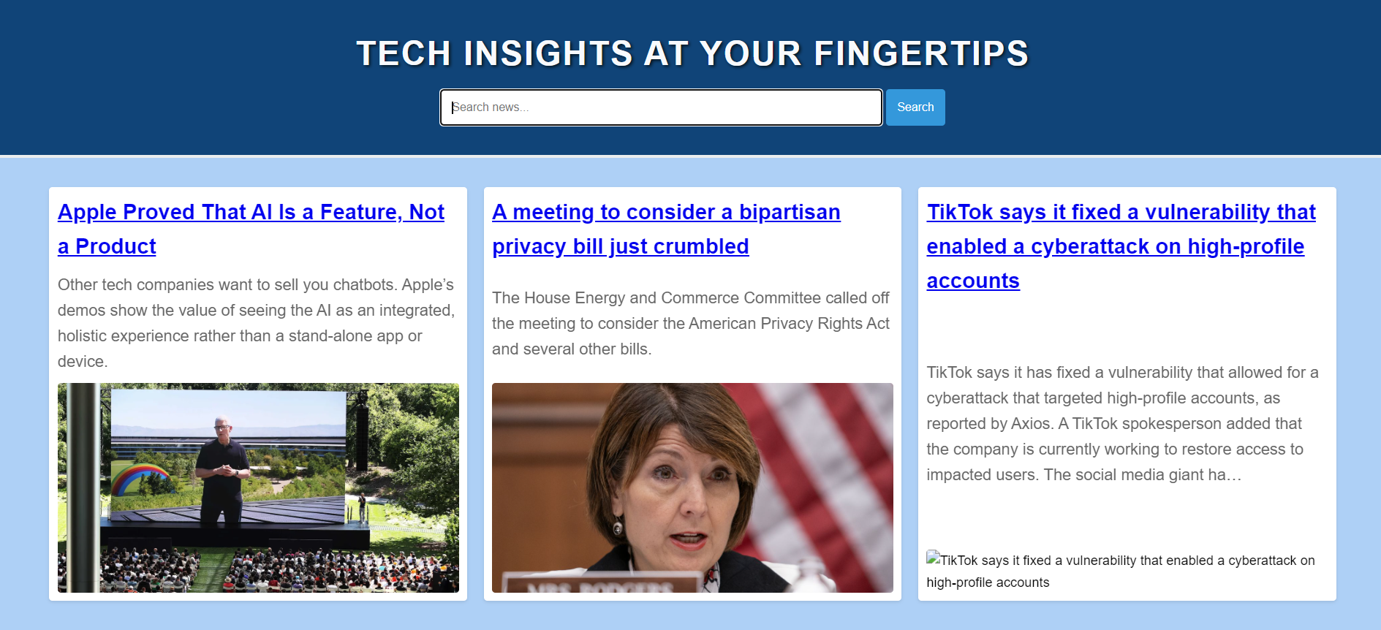
RESULTS

Slide 12
links
Github Project Link : https://github.com/grishma-gedela/Tech-News.git
News API Link : https://newsapi.org/
Web Browser : https://www.google.com/

